Slide 1
Price Discrimination

Slide 2
Price Discrimination
What is price discrimination?
Conditions for Price Discrimination
Types of Price Discrimination
Welfare effects of Price Discrimination
How is price discrimination practiced?

Slide 3
Price Discrimination
Price discrimination occurs when a firm sells the same good at different prices to different group of customers.
To practice price discrimination a firm must be a price maker. It must have some market power before it can charge more than one price.
Both monopolies and non monopoly companies use price discrimination to earn higher profits.
Can Competitive firm practice price discrimination?
Examples: Movie theatre tickets, college tuition, air line reservations, discounts on academic software and coupons

Slide 4
Conditions for Price Discrimination
Distinguishing groups of buyers
With different elasticity of demand –Consumers with elastic demand and consumers with inelastic demand
Preventing resale
For price discrimination to be viable strategy a firm must be able to prevent resale of the product or service.

Slide 5
Types of Price Discrimination
First Degree Price Discrimination
Firm would like to charge a different prices to each of its customers. If it could, it would charge each customer the maximum price that the customer is willing to pay for each unit bought. We call this maximum price the customer’s reservation price. The practice of charging each customer his or her reservation price is called perfect price discrimination or First degree price discrimination.
Second Degree Price Discrimination
Practice of charging different prices per unit for different quantities of the same good or service. Eg. Electricity tariff rates
Third Degree Price discrimination
Practice of dividing consumers into two or more groups with separate demand curves and charging different prices to each group.
Eg. Discounts to students and senior citizens.

Slide 6
Tamil Nadu’s New electricity tariff
Bi-Monthly Consumption | Units Charged For | Charge per Unit (Rs) | Energy Charges (Rs) | Fixed Charges (Rs) | Total Charges Payable (Rs)
120 | 20 | 20*1.5 | 30 | 20 | 50
160 | 60 | 60*1.5 | 90 | 20 | 110
200 | 100 | 100*1.5 | 150 | 20 | 170
300 | 200 | 100* 2 100*3 | 500 | 30 | 530
500 | 400 | 100*2 300*3 | 1100 | 30 | 1130
800 | 700 | 100*3.5 300*4.6 300*6.6 | 3710 | 50 | 3760

Slide 7
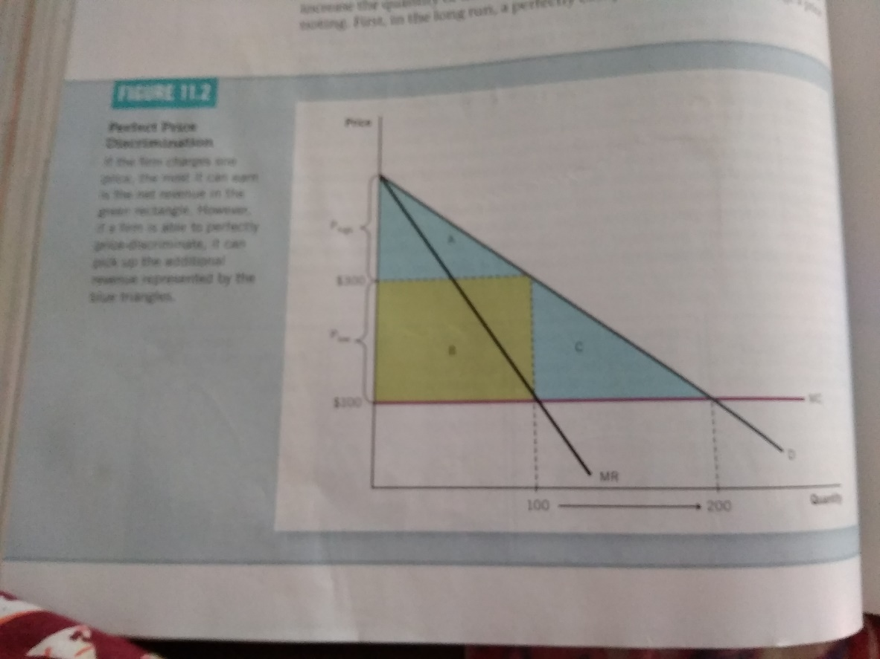
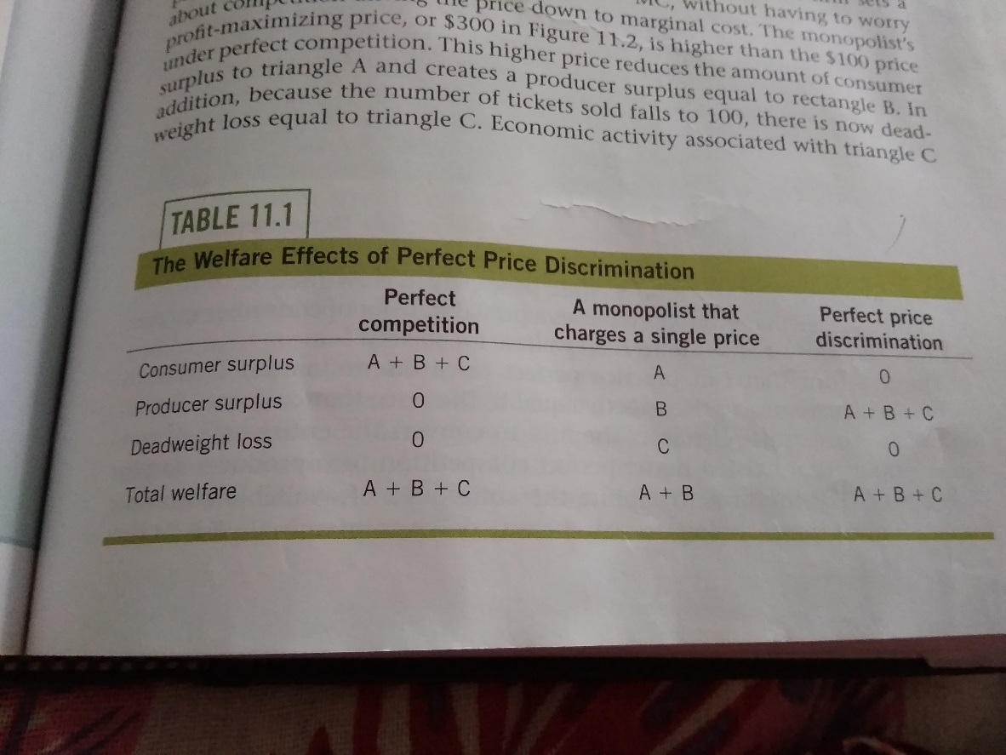
Welfare effects of price discrimination
Perfect Price Discrimination
Comparison

Slide 8
Imperfect Price Discrimination
Does not know the reservation price of each customer. Firms can discriminate imperfectly by charging a few different prices based on estimates of customers ‘ reservation prices.
Used by professionals like doctors, lawyers, accountants or architects.

Slide 9
How Price Discrimination is Practiced?
Movie tickets
Airline prices
Discount coupons
Financial aid
Quantity discounts

Slide 10
Peak load Pricing
Peak Load pricing involves charging different prices at different points in times.
For Some goods and services demand peaks at particular times. For eg.roads and tunnels during rush hour, electricity during summer, amusement parks on weekends.

Slide 11
Bundling
Bundling is the practice of selling two or more products together for a single price.
Pure Bundling: When the products are available as a package, the pricing strategy is referred to as pure bundling.
Mixed Bundling: If at least some products can also be purchased separately, then the firm is using mixed bundling.
Tying : The purchase of the main product (tying product) requires the purchase of another product (tied product) which is generally an additional complementary product.

Slide 12
Examples of Bundling
Pure Bundling:
Microsoft Office 365 is available as bundle of different applications such as word, excel, access, PowerPoint, outlook, OneNote etc. You cannot buy these applications separately, you have to buy this in bundle only. Microsoft has followed this practice because some applications are more in demand as compared to others.
Automobiles with features like AC, sun roofs and geographical systems.
Mixed Bundling:
Eg. MacDonald's Value meals
Computer package complete with a monitor, mouse, keyboard, and preloaded software for a single price.
Industries which use bundling practices include telecommunications services, software and computer companies, journal publishers, automobiles, vacation packages, and fast food restaurants, to

Slide 13
Tying
Customers who leased a photo Copying Machine had to buy Photo copy Pricing Strategies Paper.
Another case of tying was that by Kodak in which Kodak held a monopoly in the market for Kodak Copier Parts. Kodak engaged in tying when it refused to sell its parts to consumers or independent service providers except in connection with a Kodak Service Contract.
Today when you buy a Mach3 razor, you must buy the tied product i.e. the cartridge that fits into the Mach3 razor.
In India too, a number of automobile companies are providing finance and bundling the automobile with financing.

Slide 14
Transfer Pricing
Many firms are vertically integrated-they contain several divisions with some divisions producing parts and components that other divisions use to produce finished product.
For eg. Automobile companies have upstream divisions that produce engines, brakes, radiators and other components.
Downstream divisions use to produce the finished cars.
Transfer pricing are valuation of these parts and components within the firm.
Transfer prices are internal prices at which parts and components from upstream divisions are sold to down stream divisions.

Slide 15
Purpose of transfer pricing Pricing Strategies
Profits of different units can be ascertained separately and this helps in separate performance evaluation of each unit of an organization.
Transfer pricing also impact resource allocation among different units of an organization.

